Slide 1
Ensemble learning
Use multiple learning algorithms to obtain better predictive performance than could be obtained from any of the constituent learning algorithms alone.

Slide 2
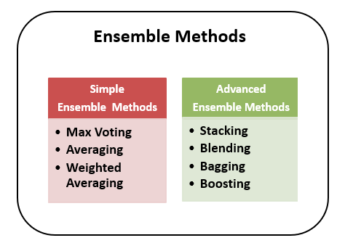

Slide 3
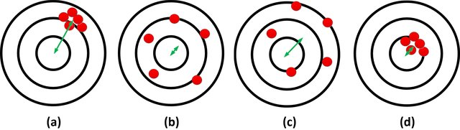
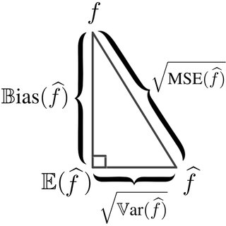
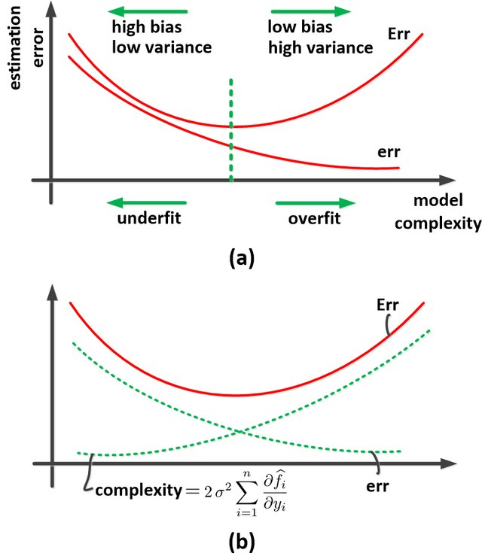
(a) high bias and low variance, (b) low bias and high variance, (c) high bias and high variance, and (d) low bias and low variance.
test
the triangle of variance, bias, and MSE.
train

Slide 4
Bagging (RF) combining the result of multiple classifiers modeled on different (“uncorrelated”) sub-samples (bootstraps) of the same data set. Decrease variance Boosting(XGboost) (linearly) combine weak learners to form strong learners (the observations are not chosen based on the bootstrap process, but based on the error) Decrease bias Stacking (log. reg. combiner) use a (parallel) combination of various classifiers Improve prediction (“black magic”)

Slide 5
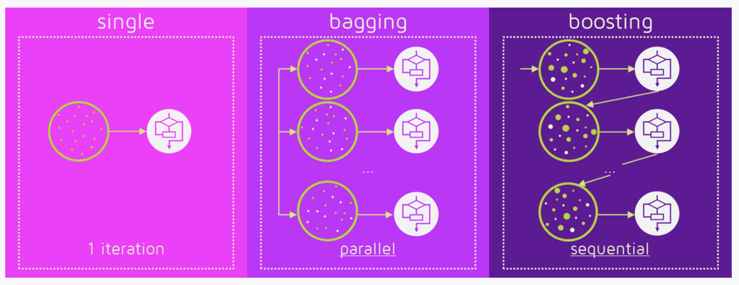
Building a model step-by-step or in parallel controls bias and variance

Slide 6
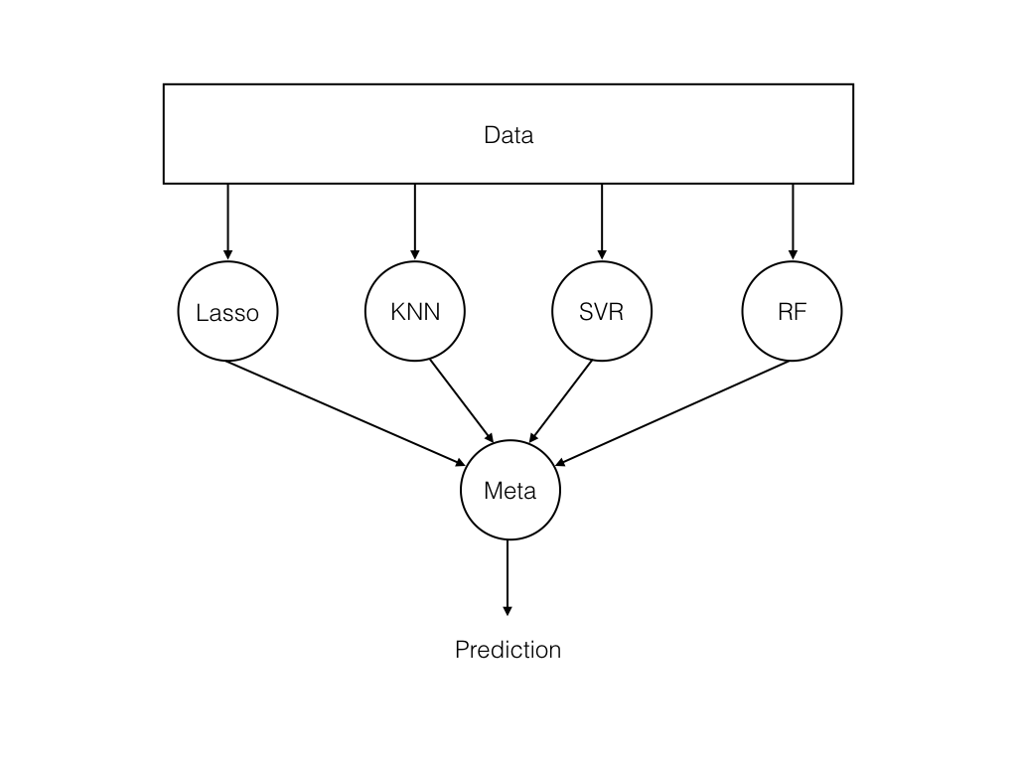
Stacking
Improve general accuracy by combining several “opinions”

Slide 7
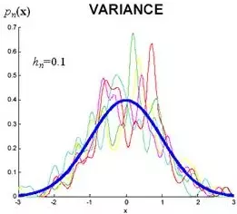
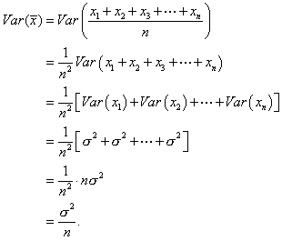
Bagging & Random forests
Reduce variance by averaging many complex models : keep the low bias of complex models but reduce variance of predictions through averaging random subspace models
for independent variables

Slide 8
on average each bootstrap sample contain roughly two thirds of observations each bootstrap sample (or bagged tree) will contain 1-1/e~0.632 of the sample: Given n items (rows) in our data, We draw items with replacement from this original set until we have another set of size n the probability of not choosing a item is 1-1/n in one draw After n (independent) draws, the probability of not choosing this item is (1-1/n)^n → 1/e

Slide 9
Out-of-bag (OOB) error
Out-of-bag (OOB) error, also called out-of-bag estimate, is a method of measuring the prediction error of random forests, boosted decision trees, and other machine learning models utilizing bootstrap aggregating (bagging) to sub-sample data samples used for training. OOB is the mean prediction error on each training sample xᵢ, using only the trees that did not have xᵢ in their bootstrap sample.^{[1]}

Slide 10
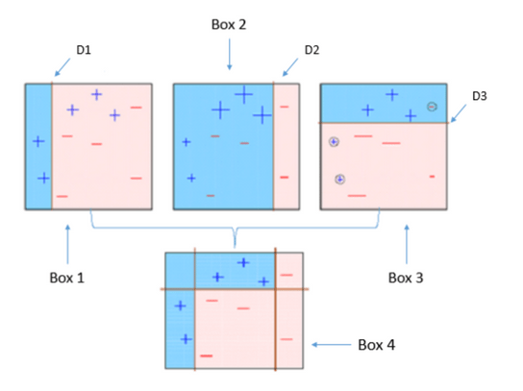
Boosting, step-by-step increase variance of high-biased models

Slide 11
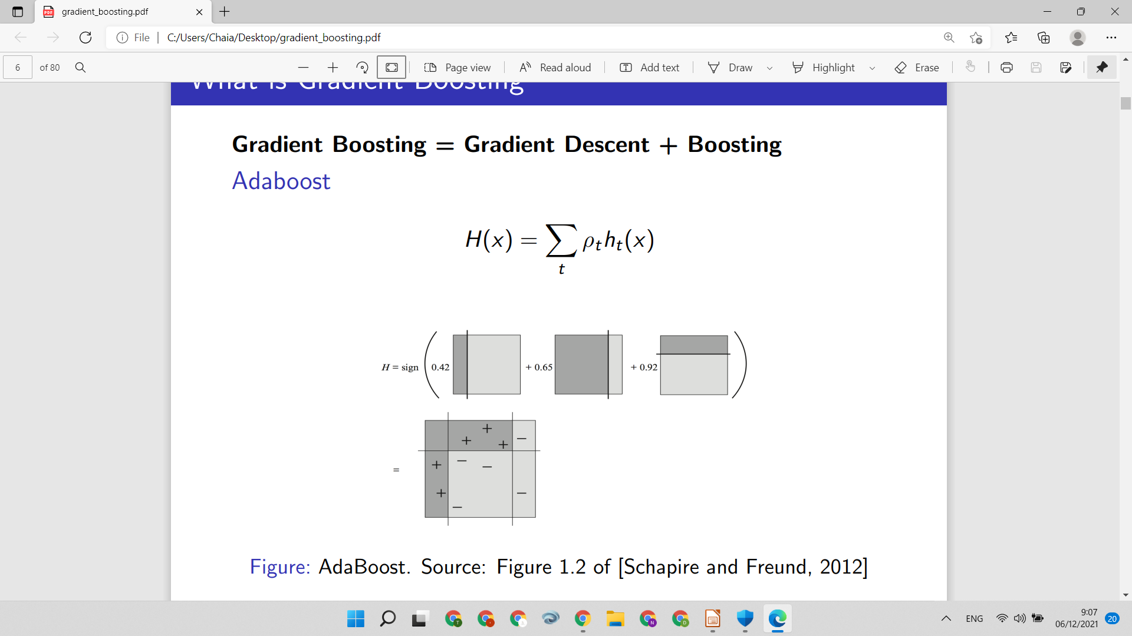
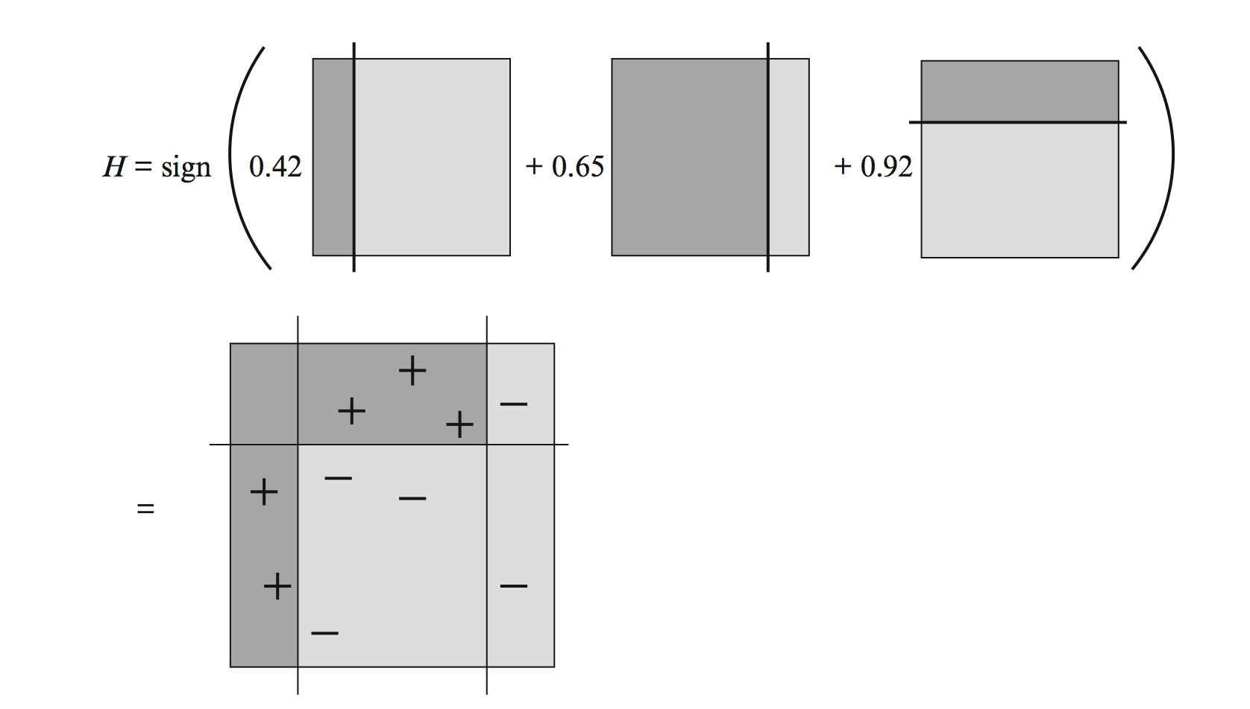
Adaboost
Adaboost fits a learner with examples re-weighted by loss generated from the previous ensemble. Gradient boosting instead fits a learner with pseudo-residuals: the negative functional gradient w.r.t. the loss.

Slide 12
Gradient Boosting
Step 1. Initialise model with a constant value (mean of the dataset).
Step 2: This step is to be followed for each base learner from m = 1 to m=M. Note that gradient boosting adds one model at a time, one after the other.
Step 2.1. Compute pseudo-residuals
Step 2.2. Fit base learners on the pseudo residuals
Step 2.3. Add new base learner to model (multiplied by “learning rate”)

Slide 13
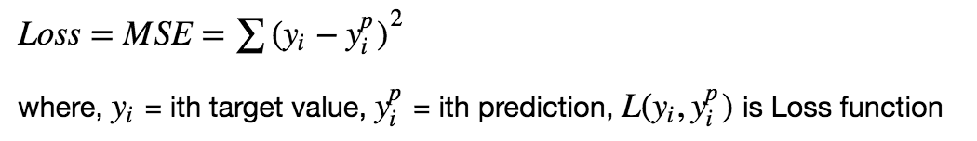
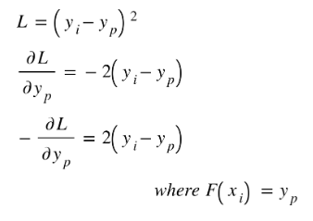
The gradient of the MSE loss function is the residual vector
For the MSE loss, the derivative (gradient) ~ the residuals and that’s the reason for the name gradient boosting
For other loss functions the gradient refers to pseudo-residuals

Slide 14
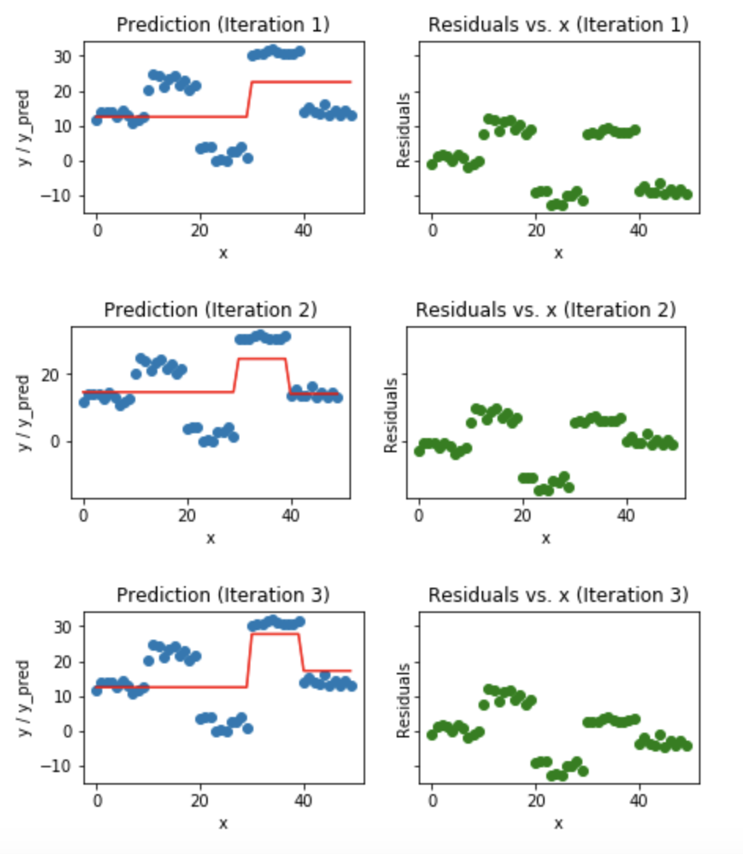
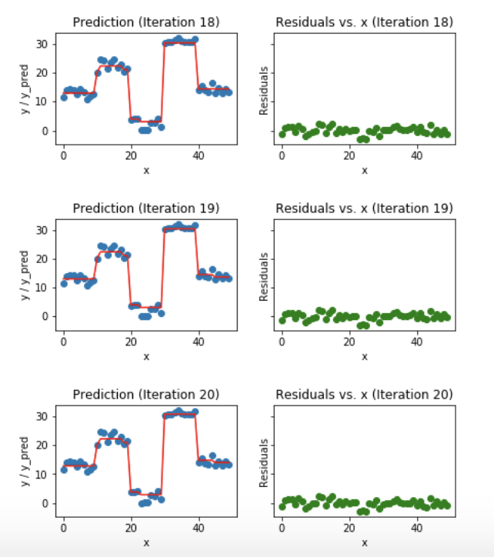

Slide 15


Comparison with gradient descent
Gradient boosting model at step m:
function h_m(x) is fitted to the rate of change of loss L w.r.t. F_{m-1}(x)
Weight adaptation in gradient descent:
Weights in gradient descent are moved in the direction in which loss L decreases

Slide 16
Gradient boosting is indeed a gradient descent algorithm, but operating at functional space. That is, to optimize the objective function we are not looking for parameters but looking for functions. In the training phase we are iteratively searching for a function (a weak learner) to be included into our model.
= a linear regression of functions not of parameters (weights)

